Slide 1

AI RECOMMENDATION ENGINE FOR E-COMMERCE WEBSITES
B. Tech. Electronic Communication Engineering – Cyber Physical Systems
Submitted by
Daniel Stauline I G
(Reg. No: 126160009)
Harish Kumar V
(Reg. No: 126160018)
Vinesh Krishna K
(Reg. No: 126160057)

Slide 2

TABLE OF CONTENT
Introduction
Literature Survey
Methodology
Results & Discussions
Conclusion
References

Slide 3
INTRODUCTION
Introduction to Recommendation Systems
Recommendation systems help users discover relevant products efficiently • Widely used in E-Commerce, streaming platforms, and social networks • Enhance user experience by delivering personalized suggestions • Reduce search time and improve decision-making for users • Major Types of Recommendation Systems: – Content-Based Filtering – Collaborative Filtering – Hybrid Approach

Slide 4
Problem & Motivation
• Users face difficulty finding the most relevant products online • E-commerce platforms show limited or repetitive suggestions • Lack of intelligent recommendations reduces user engagement • Need for a system that understands product similarity beyond keywords • Motivation: Build a smart suggestion system with better accuracy & relevance

Slide 5
Objectives & Scope
Objectives: • Develop an AI-based recommendation engine for e-commerce products • Improve recommendation accuracy using Machine Learning & Deep Learning • Provide meaningful and user-centric product suggestions
Scope: • Unified search with cross-product comparison • Supports ML and DL-based recommendation models • Can be extended for personalization in future

Slide 6
LITERATURE SURVEY
• Sarwar et al. (2001) – Proposed Collaborative Filtering for e-commerce recommendations, but required large user–item datasets and suffered from cold-start issues.
• Lops et al. (2011) – Presented Content-Based Filtering using product descriptions and metadata; worked well for known user preferences but lacked diversity and novelty in recommendations.
• Mikolov et al. (2013) – Introduced Word2Vec for capturing semantic meaning of text; improved similarity understanding beyond keyword matching and became a base for deep recommendation models.

Slide 7
• Sedhain et al. (2015) – Applied Autoencoder models for recommendation systems, showing improved accuracy over traditional CF but required high computational resources.
• Covington et al. (2016) – Developed Deep Neural Networks for YouTube Recommendations, achieving high-quality personalization but using complex architectures and large datasets.
• Kumari & Singh (2020) – Used Hybrid ML-DL recommendation models combining TF-IDF and deep learning for e-commerce, showing improved accuracy but lacked image- and behavioral-based integration.

Slide 8
METHODOLOGY
Dataset Creation
• Created product dataset containing: product_id, product_name, category, price, rating, rating_count, description & features • Performed data cleaning: removed duplicates, handled missing values, normalized text format • Standardized data: converted price to numeric, normalized rating to 0–1, unified category names
Filtered and structured final dataset: ~1457 records after cleaning and category balancing • Prepared train/validation/test split for model training • Exported reusable files for backend integration (e.g., catalog_lookup.csv, encoders, scalers, vectorizers)

Slide 9
Data Preprocessing, Feature Engineering & TF-IDF
• Text Preprocessing:
– Standardized text for uniform processing (lowercasing, punctuation & stop-word removal) – Tokenization performed to convert sentences into meaningful word tokens – Improved text quality for vectorization and embedding generation
• Feature Engineering:
– Text Feature: Constructed unified_text by merging product name + description + features to form a single rich contextual field for modeling

Slide 10
• Model-Specific Feature Bundles:
– ML Recommendation (TF-IDF + KNN): Used TF-IDF vectors of unified_text for similarity-based product retrieval
• TF-IDF (Term Frequency – Inverse Document Frequency): – Converts text into weighted numerical vectors by scoring word relevance across the dataset – TF: Measures how frequently a word appears in a product description – IDF: Reduces weight of common words and increases weight of rare but meaningful terms – Provides strong baseline for content similarity due to fast computation, interpretability, and effectiveness for textual comparison

Slide 11
Word2Vec + Hybrid Autoencoder
• Word2Vec was first used to convert product text into semantic vectors, allowing the model to understand meaning beyond exact keywords • The product text was tokenized and trained using the skip-gram model, producing word embeddings where similar-meaning words lie close in vector space • A product-level embedding was then created by averaging all word vectors in the product text, giving a semantic representation for each product
• To overcome Word2Vec’s limitations, a Hybrid Autoencoder was built to learn deeper product representations

Slide 12
K-Nearest Neighbors (KNN)
• Used to recommend the top-N most similar products to a given query • Product text is first converted into TF-IDF vectors to represent textual information numerically • Cosine distance is applied on these vectors to measure similarity between products • The system then uses KNN to search for nearest neighbors, ranking products based on similarity scores • This approach provides a simple and fast baseline for content-based recommendations without the need for model training • However, it depends only on matching keywords and does not understand meaning or context, which limits semantic accuracy

Slide 13
Random Forest Classifier
• Implemented to predict the correct product category based on product attributes • Uses a combination of numerical features (price, rating, pop_score), TF-IDF (optional), and one-hot encoded category data as inputs • Random Forest was chosen because it handles noisy and nonlinear data well, improving classification reliability • The model provides feature importance, helping identify which product features influence category prediction the most • Achieved ~100% accuracy after balancing category data, showing strong classification performance • A limitation is that it may overfit on small or imbalanced categories and requires more memory due to multiple decision trees

Slide 14
Support Vector Machine (SVM) Classifier
• SVM was implemented to predict the product category, similar to the Random Forest model • The model uses an RBF kernel, which performs well in high-dimensional feature spaces such as TF-IDF text data • It learns an optimal decision boundary that separates product categories with maximum margin, improving generalization • During evaluation, the SVM achieved ≈98.63% accuracy, demonstrating strong precision and recall across major product categories • This makes SVM a reliable classifier for text-rich data, especially when classes are well-separated • However, it is sensitive to hyperparameters (C and γ) and is less interpretable compared to Random Forest

Slide 15
• The Autoencoder takes a combined input of Word2Vec embedding + scaled numeric features (price, rating, popularity) + one-hot category, forming a ~107-dimensional vector • Its encoder compresses this into a 64-dimensional latent vector, capturing the important hidden patterns across text, price, and category together • This latent representation enables more accurate, context-aware product similarity compared to surface-level text models like TF-IDF

Slide 16
Re-Ranking (Score Fusion)
After generating recommendations from ML and Deep Learning models, a Re-Ranking step is applied to refine the final Top-N product list • This step combines multiple signals to ensure the recommendations are not only relevant, but also useful and practical for the user
• The system calculates three key scores: – s_ML: similarity score from TF-IDF + KNN – s_DL: semantic similarity score from Deep KNN (Autoencoder) – s_meta: optional score based on business/user rules (ratings, price fit, diversity, brand preference)

Slide 17
These scores are fused to generate an overall ranking using a weighted formula: FinalScore = α·s_DL + β·s_ML + γ·s_meta (α ≥ β > γ) – Example: α=0.6, β=0.3, γ=0.1 (gives more importance to deep learning model)
• Additional re-ranking rules ensure high-quality results: – Break ties using higher rating → then popularity score – Reduce repetition of same/duplicate products to improve variety – Consider user constraints such as price range or preferred brands
• Outcome: Produces a more reliable, diverse, and user-friendly final recommendation list, combining semantic relevance + keyword match + user value

Slide 18
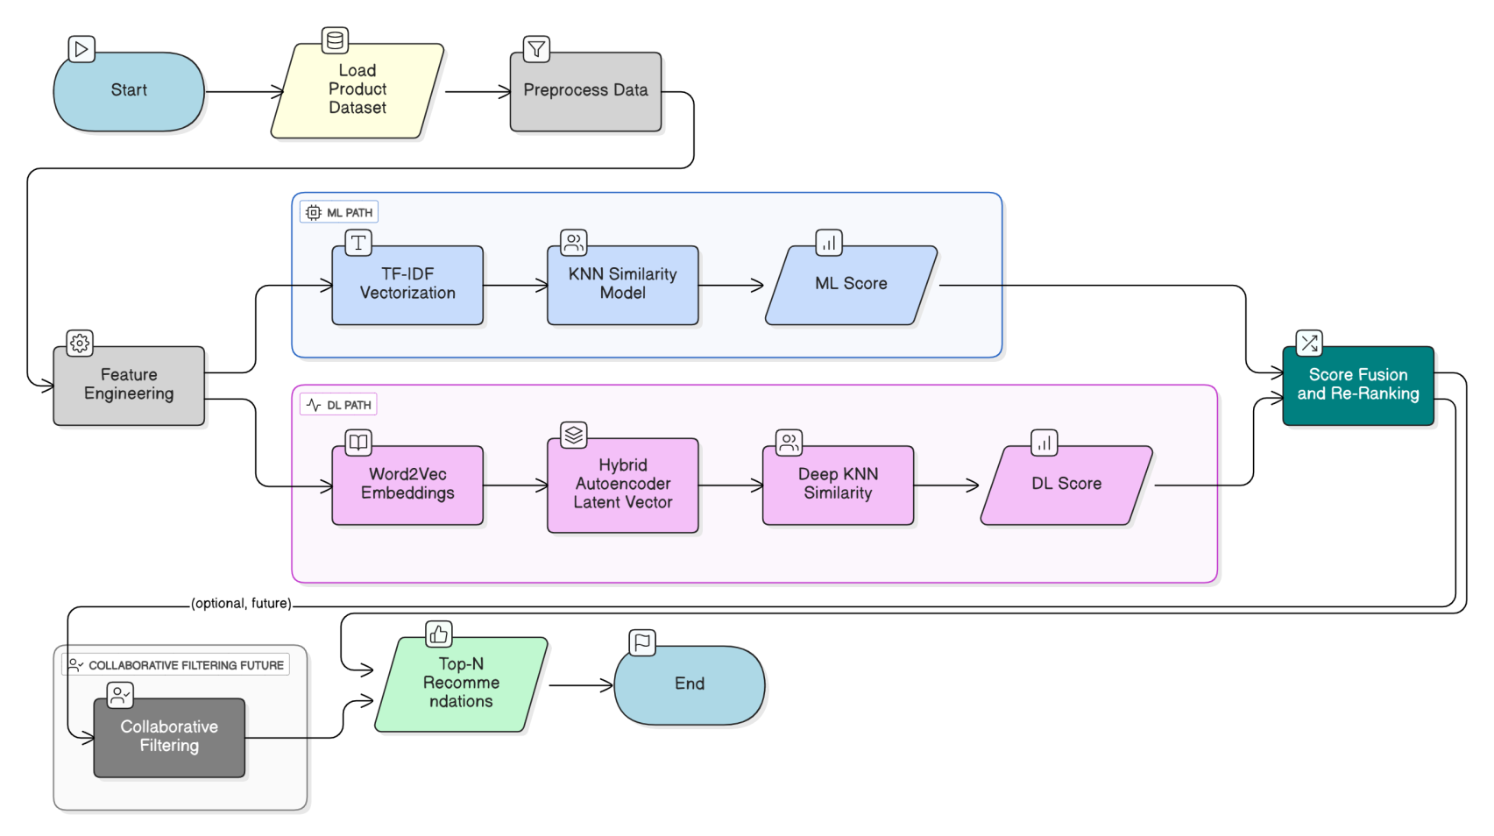
Hybrid Recommendation System Workflow

Slide 19
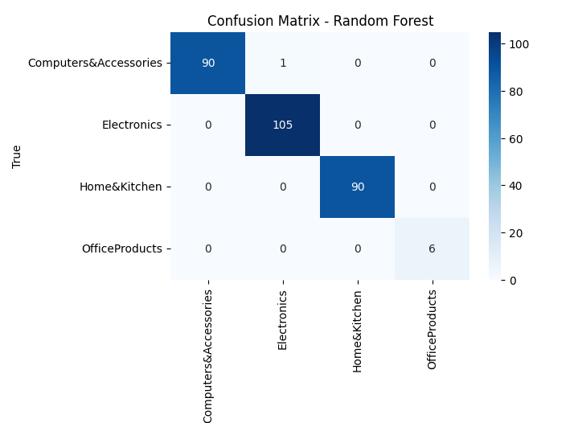
RESULTS AND DISCUSSIONS
• Random Forest was used for multi-class product category classification • Model performs consistently across all categories including minority class (Office Products) • Demonstrates strong capability for category prediction useful in filtering & recommendation ranking
Fig: Random Forest Classification Performance
Random Forest Accuracy: 99.66%

Slide 20
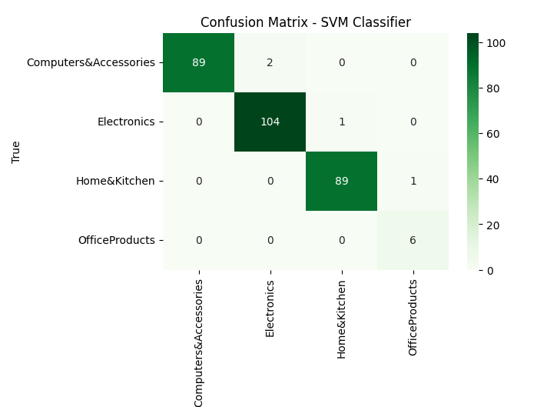
• SVM used for multi-class product category classification • Performs well in high-dimensional feature space (TF-IDF text + numeric features) • Very high precision and recall across major categories
SVM Accuracy: 98.63%
Fig: SVM Classification Performance
SVM delivered strong performance close to Random Forest, making it a reliable model for category prediction with high generalization capability.

Slide 21
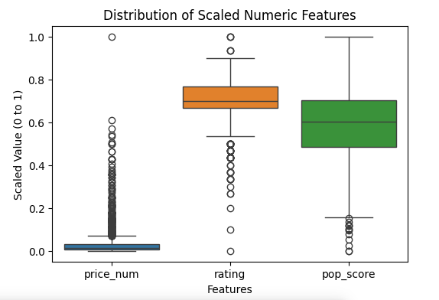
Min–Max Scaling used to transform numeric features into 0–1 range
Ensures fair contribution of price, rating, and popularity in ML/DL models
Prevents large price values from dominating model learning
Normalized values improve training stability and model performance
Figure: Distribution of Scaled Numeric Features after Normalization

Slide 22
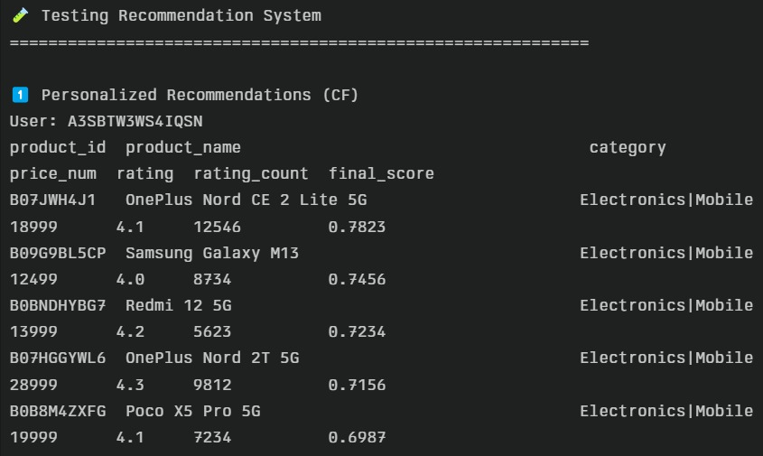
Final System Output – Backend Recommendation Results
Successfully integrated ML/DL models into backend recommendation engine
Displays personalized recommendations with product details & final scores
Shows ranking based on hybrid scoring (Deep + ML + Meta factors)
Confirms correct functioning of the model outside training environment

Slide 23
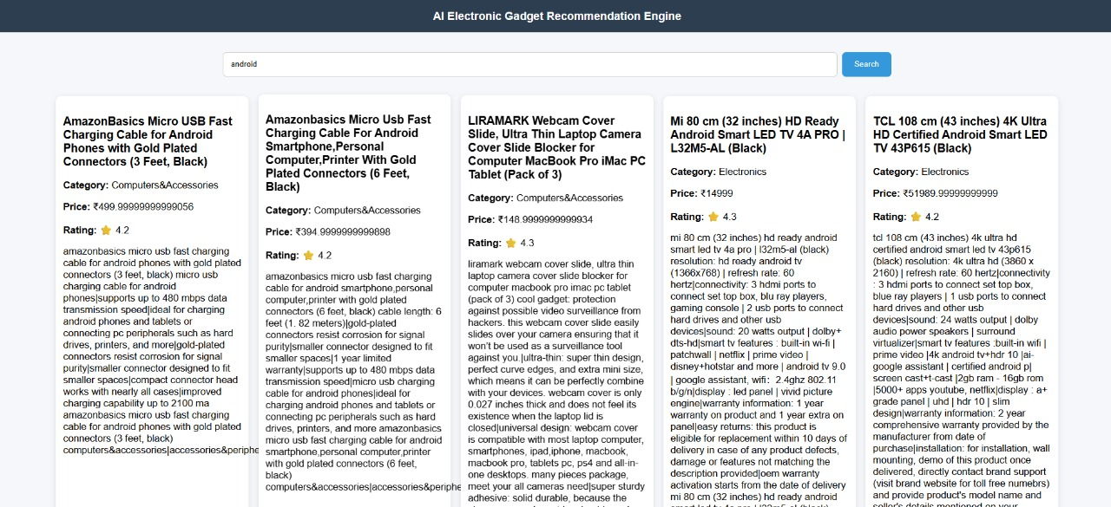
Final UI Output – Recommendation Engine Frontend
User can enter a query (e.g., “Android”) and receive relevant product recommendations
Recommendations display product name, category, price, rating & key features
UI presents results in a card-layout for clear and user-friendly browsing
Model outputs are successfully consumed by frontend → proves end-to-end integration

Slide 24
Future Work - Collaborative Filtering
Collaborative Filtering (CF) is planned as a future enhancement to make the system personalized for each user • Unlike content-based models, CF recommends products based on user behavior patterns and community preferences
• Types of Collaborative Filtering: – User-User CF: Finds users with similar tastes and recommends what they liked – Item-Item CF: Recommends items frequently chosen together or by similar users – Matrix Factorization (SVD/ALS): Learns hidden user and item factors using ratings/purchase interactions – Implicit CF: Uses actions like clicks, views, cart-adds instead of explicit ratings

Slide 25
CONCLUSION
The project successfully built an end-to-end AI-based E-Commerce Product Recommendation System, starting from raw data and progressing to a fully functional user interface.
Dataset was cleaned, standardized, enriched, and transformed through preprocessing and feature engineering to create high-quality inputs for model training.
Multiple models were developed to strengthen the system:
✓ TF-IDF + KNN for content-based similarity ✓ Random Forest & SVM for category prediction with high accuracy ✓ Word2Vec + Autoencoder + Deep KNN for deep semantic product matching
A hybrid score fusion and re-ranking mechanism combined outputs from ML and DL models to deliver more accurate and meaningful Top-N product recommendations.

Slide 26
All trained models, embeddings, and preprocessing tools were saved and integrated into a backend system to enable real-time recommendation generation.
A user-friendly UI was implemented to display personalized product suggestions, demonstrating a complete pipeline from data processing → model building → deployment.
The integrated ML + DL approach improved recommendation accuracy, relevance, and user experience, establishing a strong foundation for future enhancements such as collaborative filtering and real-time personalization.

Slide 27
REFERENCES
Research Papers:
G. Linden, B. Smith, and J. York, "Amazon.com Recommendations: Item-to-Item Collaborative Filtering," IEEE Internet Computing, vol. 7, no. 1, pp. 76-80, January-February 2003. DOI: 10.1109/MIC.2003.1167344
Y. Hu, Y. Koren, and C. Volinsky, "Collaborative Filtering for Implicit Feedback Datasets," in Proceedings of the 8th IEEE International Conference on Data Mining (ICDM), Pisa, Italy, 2008, pp. 263-272. DOI: 10.1109/ICDM.2008.22
Online Resources
"TensorFlow: An End-to-End Open Source Machine Learning Platform," Google TensorFlow, 2025. [Online]. Available: https://www.tensorflow.org/.
"Pandas Documentation," pandas Development Team, 2025. [Online]. Available: https://pandas.pydata.org/docs/.

Slide 28
Thank You!

